Slide 1
Object Oriented Programming : Class, Objects and Inheritance

Slide 2
Introduction
Python is an object oriented language.
Object oriented languages helps programmer to reduce complexity of programs
The general concept of object oriented programming language is about class.
The class is just another name for a type in python.
Where as Objects are instances of a class
An object is a container of data: attributes
An object has associated functions: methods

Slide 3
Defining Classes
The class is just another name for type in python.
The class may contain data in the form of fields.
Fields are also called as attributes and code in the form of procedure known as methods.
The Syntax for defining Class is as follows
Class Class_Name: Initializer attributes methods() statements

Slide 4
A simple class program
Write a simple class program and print the message “Welcome to Classes”.
class MyFirstClassProgram: print(' Welcome to Classes') C=MyFirstClassProgram() #Instance of class print(C) Output: Welcome to Classes <__main__.MyFirstClassProgram object at 0x023F5030>

Slide 5
Adding, Assigning & Accessing values to an Attribute
Adding attribute to the class
The syntax to add attribute to the class is as follows
class class_name:
attribute_name = value
…………………………………………………………
Accessing attributes of a class
The following syntax is used to access attributes of a class
<object>.<attribute>
Assigning values to an attributes outside the class
<object>.attribute = Value

Slide 6
class Rectangle: length=0; #Attribute length breadth=0; #Attribute breadth R1 = Rectangle () #Instance of a class print('Initial values of Attribute') print('Length = ',R1.length) #Access attribute length print('Breadth = ',R1.breadth) #Access attribute breadth print('Area of Rectangle = ',R1.length * R1.breadth ) R1.length = 20 #Assign value to attribute length R1.breadth = 30 #Assign value to attribute breadth print('After reassigning the value of attributes') print('Length = ',R1.length ) print('Breadth = ',R1.breadth ) print('Area of Rectangle is ',R1.length * R1.breadth) Output: Initial values of Attribute Length = 0 Breadth = 0 Area of Rectangle = 0 After reassigning the value of attributes Length = 20 Breadth = 30 Area of Rectangle is 600

Slide 7
Adding Methods to The Class
Class consist of two things i.e. instance variable and instance methods.
The syntax to add methods to the class is follows
Note:
The first parameter for each method should be self if method exist within the class.
The self parameter references the object itself.
class Class_Name: instance variable; #instance variable with initialization def mthod_name(self,param_list):#Parameter List is Optional block_of_statements

Slide 8
Program:
Program to create method Display_Message() display message “Hello, Learn Adding Methods” within the methods.
class Demo: def Display_Message(self): print('Hello, Learn Adding Methods') D1 = Demo() D1.Display_Message() Output: 'Hello, Learn Adding Methods

Slide 9
Program
Write a program to calculate area of circle
import math class Circle: def calc_area(self,radius): print(‘radius= ‘, radius) return math.pi*radius**2 C1=Circle() print(' The area of Circle is ',C1.calc_area(5)) Output: The area of Circle is 78.5

Slide 10
Program
Write a program to calculate area of rectangle
import math class rectangle: def calc_area(self,length,breadth): print(‘length= ‘, length) print(‘breadth= ‘, breadth) return length*breadth C1=rectangle() print(' The area of rectangle is ',C1.calc_area(4,5)) Output: The area of rectangle is 20

Slide 11
Self parameter with instance variable
self is used to differentiate between instance and local variable.
e.g x displays the value of local variable and self.x displays the value of instance variable
class prac: x=5 # instance variable def display(self,x): x=30 # local variable print('value of local variable x is = ', x) print('value of instance variable x is = ', self.x) ob=prac() ob.display(50) Output: value of local variable x is = 30 value of instance variable x is = 5

Slide 12
Self parameter with method
self is used within methods to call another method from the same class.
class self_demo: def method_A(self): print('In method A') print('We got a call from A') def method_B(self): print(' In method_B calling method_A') self.method_A() ob=self_demo() ob.method_B() Output: In method_B calling method_A In method A We got a call from A

Slide 13
Display class attribute and methods
By using dir(), attributes of class can be displayed
class Displaydemo: Name=' '; Age= ' '; def read(self): Name=input('enter Name: ') print('Name= ', Name) Age=input('enter Age: ') print('Age= ', Age) C1=Displaydemo() C1.read() >>> dir(Displaydemo()) ['Age', 'Name', '__class__', '__delattr__', '__dict__', '__dir__', '__doc__', '__eq__', '__format__', '__ge__', '__getattribute__', '__gt__', '__hash__', '__init__', '__init_subclass__', '__le__', '__lt__', '__module__', '__ne__', '__new__', '__reduce__', '__reduce_ex__', '__repr__', '__setattr__', '__sizeof__', '__str__', '__subclasshook__', '__weakref__', 'read‘]

Slide 14
The __init__ method (Constructor)
The __init__ method is known as an initializer.
It is a special method that is used to initialize instance variable of an object.
This method run as soon as an object of a class is instantiated.
The syntax of adding __init__ method to class is follows
Note:
a) __init__ method must have self as first argument.
b) As self refers to the object itself. Therefore it refers to the object that invokes the method.
class Class_Name: def _init_(self): #__init__ method ………………………… …………………………

Slide 15
Program
Write a program to initialise the value of attributes to calculate area of circle by making use of __init__ method.
class Circle: pi=0; radius=0 def __init__(self,s): self.pi = 3.14 self.radius=s def calc_area(self): return self.pi*self.radius**2 C1=Circle(4) print(' The area of Circle is ',C1.calc_area()) Output: The area of Circle is 50.24

Slide 16
Write a program to initialise the value of attributes to calculate area of circle by making use of __init__ method.
class Circle: pi=0; __radius=0 def __init__(self,s): self.pi = 3.14 self.__radius=s def calc_area(self): return self.pi*self.__radius**2 C1=Circle(4) print(' The area of Circle is ',C1.calc_area()) print(C1.__radius) Output: The area of Circle is 50.24 Traceback (most recent call last): File "<string>", line 11, in <module> AttributeError: 'Circle' object has no attribute '__radius'

Slide 17
Write a program to calculate the addition of two complex numbers by passing objects as a parameter.
class complex1: real=0 imag=0 def __init__(self,r,i): self.real=r self.imag=i def calculate(self,obj1,obj2): print(' complex number1 is ', obj1.real , '+', obj1.imag,'i') print(' complex number2 is ', obj2.real , '+', obj2.imag,'i') self.real=obj1.real+obj2.real self.imag=obj1.imag+obj2.imag obj1=complex1(10,20) obj2=complex1(20,30) obj3=complex1(0,0) obj3.calculate(obj1,obj2) print(' complex number (addition of two complex numbers is ', obj3.real , '+', obj3.imag,'i‘)
OUTPUT: complex number1 is 10 + 20 i complex number2 is 20 + 30 i addition of two complex numbers is= 30 + 50 i

Slide 18
The __del__() (Destructor Method)
The method __del__ denotes the destructor
Following is the syntax to define destructor.
Syntax:
def __del__(self):
statement block
Python invokes destructor method when instance is about to be destroyed.
The self refers to the instance on which __del__() method invoked.

Slide 19
Write a program to demonstrate the working of Destructor.
class DestructorDemo: def __init__(self): print('Welcome to Python') def __del__(self): print('Destructor executed...') ob1=DestructorDemo() ob2=DestructorDemo() ob3=ob2 print(' Id of ob1 = ', id(ob1)) print(' Id of ob2 = ', id(ob2)) print(' Id of ob3 = ', id(ob3)) del ob1 del ob2 del ob3
OUTPUT: (Why destructor is called twice????) Welcome to Python Welcome to Python Id of ob1 = 37883888 Id of ob2 = 38582736 Id of ob3 = 38582736 Destructor executed... Destructor executed...

Slide 20
Write a program to demonstrate the working of method overloading ( using *args)
class DemoOverload: result=0 def add(self, instanceOf=None, *args): if instanceOf=='int': self.result=0 if instanceOf=='str': self.result=' ' for i in args: self.result=self.result+i return self.result D1=DemoOverload() print(D1.add('int',10,20,30)) print(D1.add('str', 'India ','is ','Great'))
OUTPUT: 60 India is Great

Slide 21
Inheritance
Inheritance is one of the most useful and essential characteristics of object-oriented programming.
The existing classes are main components of inheritance. The new classes are created from existing one.
The properties of existing classes are simply extended to the new classes.
The new classes created using such method are known as derived classes or sub class and the existing classes are known as base class or super class.

Slide 22
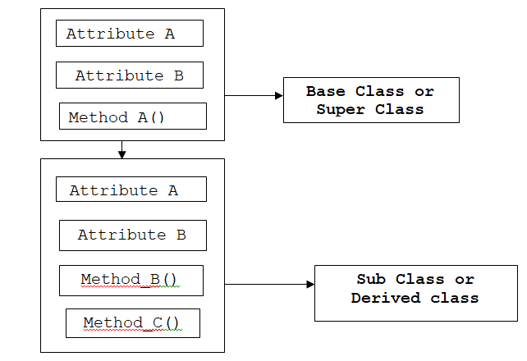
Example of Inheritance

Slide 23
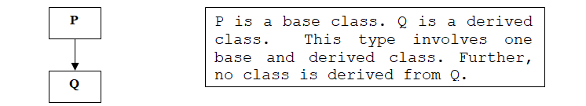
Type of Inheritance
Single Inheritance
Only one base class is used for derivation of a new class. Further, the derived class is not used as base class.
Syntax to inherit single Base class:
Class Derived_Class_Name(Single_Base_Class_Name): Body_of_Derived_Class

Slide 24
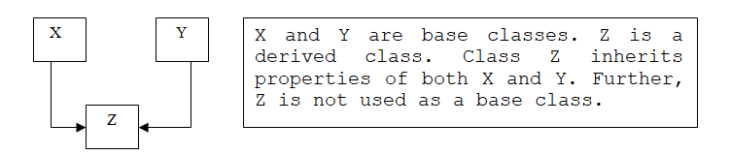
Inheritance continued…..
Multiple Inheritance
When two or more base classes are used for derivation of a new class is called multiple Inheritance.
Class Derived_Class_Name(Comma_Seperated_Base_Class_Names): Body_of_Derived_Class

Slide 25
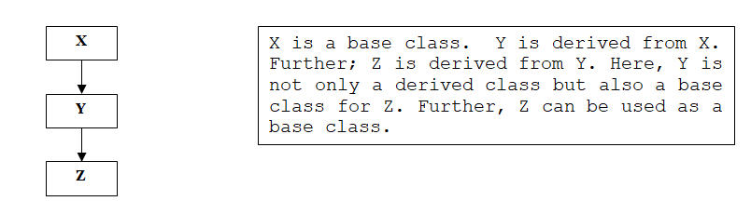
Inheritance continued…..
Multilevel Inheritance
When a class is derived from another derived class i.e. derived acts as base class. Such type of inheritance is known as Multilevel Inheritance.
Class Derived_Class1_Name(Base_Class_Name): Body_of_Derived_Class1 Class Derived_Class2_Name(Derived_Class1_Name): Body_of_Derived_Class2 …………

Slide 26
Program: Single Inheritance
class A: def Message1(self): print('I am in A') class B(A): def Message2(self): print('I am in B') D1 = B() D1.Message2() D1.Message1()
Output:
I am in B
I am in A

Slide 27
Program: Multilevel Inheritance
class A: def Message1(self): print('I am in A') class B(A): def Message2(self): print('I am in B') class C(B): def Message3(self): print('I am in C') D1 = C() D1.Message3() D1.Message2() D1.Message1()
Output:
I am in C
I am in B
I am in A

Slide 28
Program: Hierarchical Inheritance
class A: def Message1(self): print('I am in A') class B(A): def Message2(self): print('I am in B') class C(A): def Message3(self): print('I am in C') D1 = B() D1.Message2() D1.Message1() D2 = C() D2.Message3() D2.Message1()
Output:
I am in B
I am in A
I am in C
I am in A

Slide 29
Program: Multiple Inheritance
class A: def Message1(self): print('I am in A') class B: def Message2(self): print('I am in B') class C(A,B): def Message3(self): print('I am in C') D1 = C() D1.Message3() D1.Message2() D1.Message1()
Output:
I am in C
I am in B
I am in A

Slide 30
Method Overriding : When a method in sub class has same name and header as that of super class, then method in sub class is said to override the method in the super class.
class A: def Message(self): print('I am in A') class B(A): def Message(self): print('I am in B') D1 = B() D1.Message()
Output:
I am in B

Slide 31
Program: Method overriding using super()
class A: def Message(self): print('I am in Super class A') class B(A): def Message(self): super().Message()# call to base class method print('I am in Sub class B') D1 = B() D1.Message()
Output:
I am in Super class A
I am in Sub class B

Slide 32
Program: Method overriding in Multiple Inheritance
class A: def Message(self): print('I am in A') class B: def Message(self): print('I am in B') class C(A,B): def Message(self): A.Message(self) B.Message(self) print('I am in C') D1 = C() D1.Message()
Output:
I am in A
I am in B
I am in C

Slide 33
Program: Super to call super class constructor
class BaseDemo: a=0 b=0 c=0 def __init__(self,A,B,C): self.a=A self.b=B self.c=C def display(self): print( self.a, self.b, self.c) class DerivedDemo(BaseDemo): d=0 def __init__(self,A,B,C,D): self.d=D super().__init__(A,B,C) def display(self): print( self.a, self.b, self.c, self.d) #B=BaseDemo(10,20,30) #print('content of Base class: ') #B.display() P=DerivedDemo(10,20,30,40) print('content of derived class: ') P.display()
Output:
content of derived class:
10 20 30 40

Slide 34
Operator Overloading
It means to assign a special meaning to the existing operator to perform some intended task.
E.g. ‘+’ operator is used to add two numbers, same can be used to concatenate two strings
Similarly two class objects can be added by using the concept of operator overloading.

Slide 35
Program: Overloading arithmetic operator
class num:
def __init__(self,n):
self.number=n
def __add__(self,obj):
return (self.number+obj.number)
def __sub__(self,obj):
return (self.number-obj.number)
def __mul__(self,obj):
return (self.number*obj.number)
def __truediv__(self,obj):
return (self.number/obj.number)
def __mod__(self,obj):
return (self.number%obj.number)
def __floordiv__(self,obj):
return (self.number//obj.number)
def display(self):
print('number is : ',self.number)
n1= num(30)
n2= num(12)
print('addition of n1 and n2 is‘, n1+n2)
print('subtraction of n2 from n1 is', n1-n2)
print('multiplication n1 with n2 is', n1*n2)
print('result of n1/n2 is', n1/n2)
print('result of n1//n2 is', n1//n2)
print('result of n1%n2 is', n1%n2)
Output:
addition of n1 and n2 is 42
subtraction of n2 from n1 is 18
multiplication n1 with n2 is 360
result of n1/n2 is 2.5
result of n1//n2 is 2
result of n1%n2 is 6

Slide 36
Program: Overloading ‘+’ operator
class complex:
def __init__(self, real,imag):
self.real=real
self.imag=imag
def __add__(self,obj):
real=self.real+obj.real
imag=self.imag+obj.imag return (complex(real,imag))
def display(self):
print(self.real,' +', self.imag,"i")
c1=complex(10,20)
c2=complex(23,12)
c1.display()
c2.display()
c3=c1+c2
c3.display()

Slide 37
Program: Overloading relational operator
class num:
def __init__(self,n):
self.number=n
def __gt__(self,obj):
return (self.number>obj.number)
def display(self):
print(‘number is : ‘,self.number)
n1= num(20)
n2= num(12)
print(n1>n2)

Slide 38
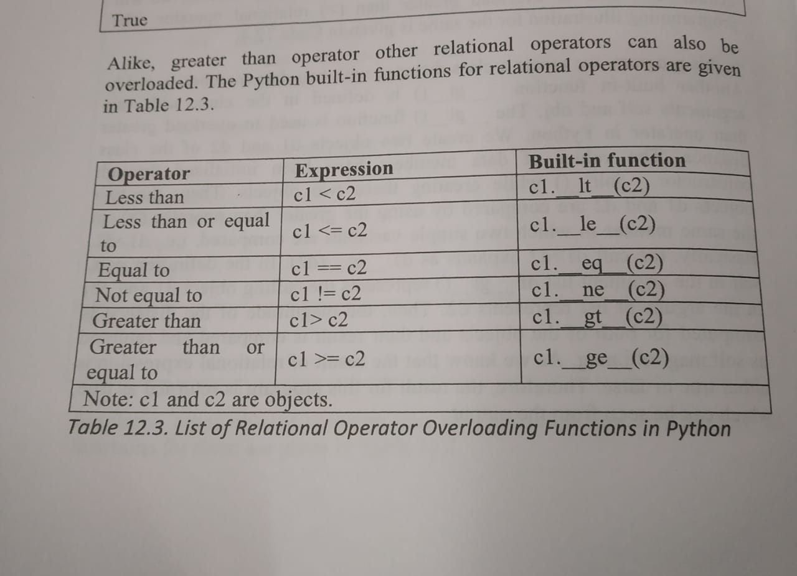

Slide 39
Conclusion……
class and objects that reduces the complexity of programs.
Attributes and member function belongs to the class.
The self parameter is used to reference object itself
A programmer can initialize the value of member variable or attribute by making use of __init__ method.
Python also supports various types of inheritance such as single inheritance, multiple and multi level inheritance.

